Slide 1

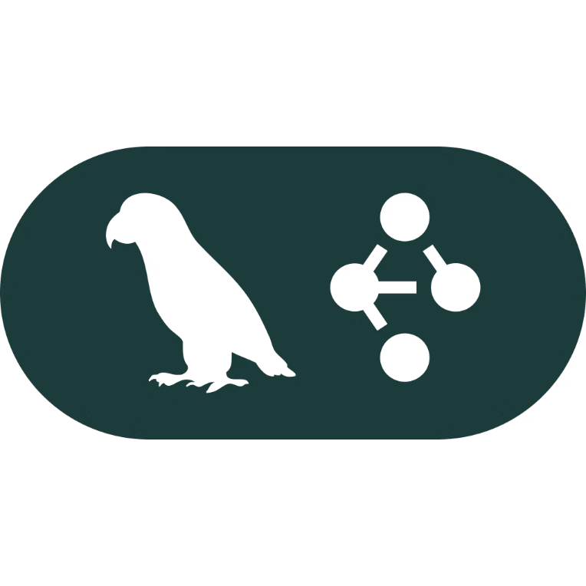
LangGraph: Building Reliable Agentic AI Workflows
An Introduction to Agentic AI and Stateful Orchestration

Slide 2
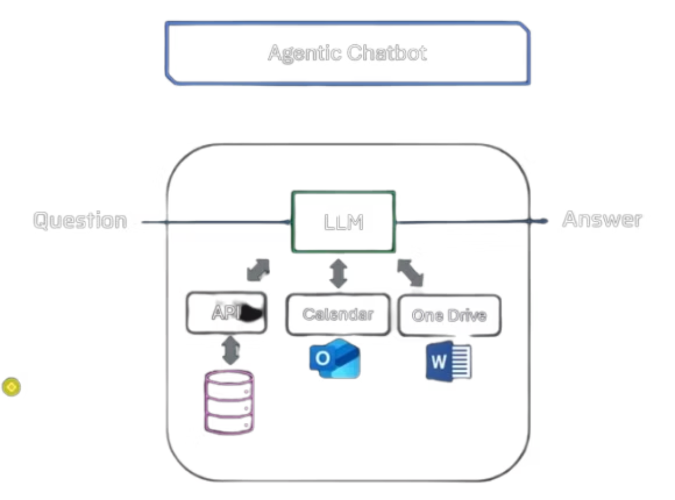
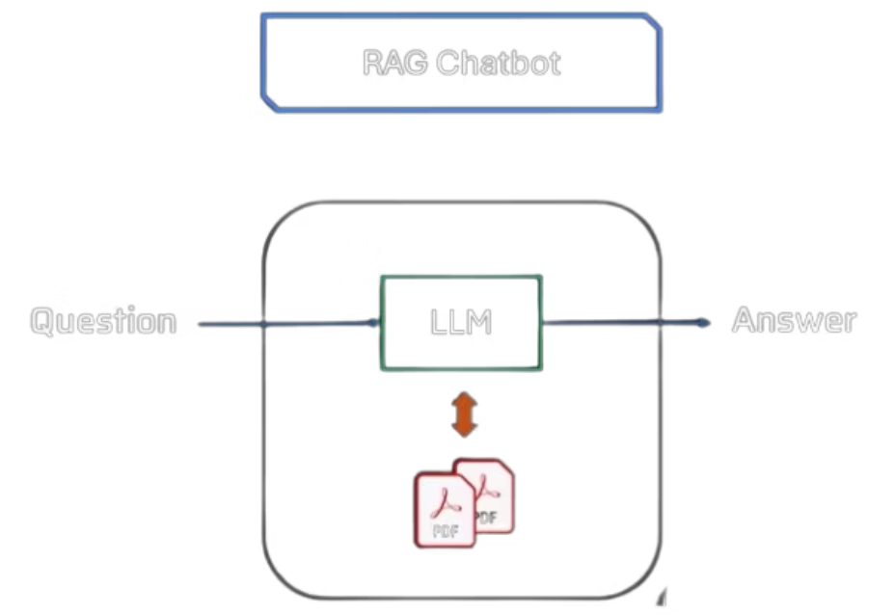
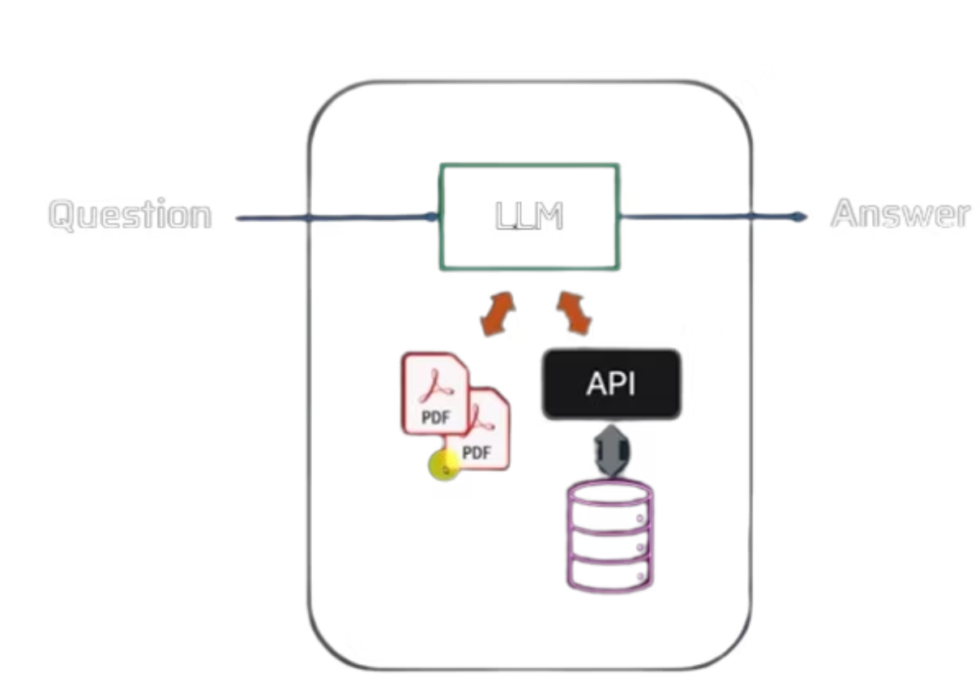
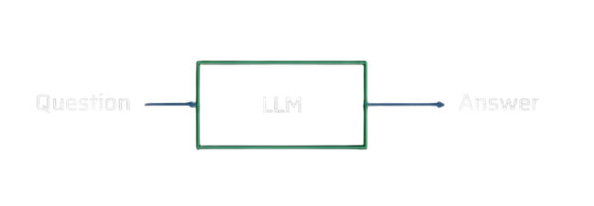
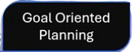
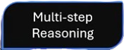
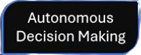
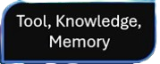
Workflow vs Agentic AI
What is a generic leave policy in an IT company ?
What is the leave/insurance policy of Wells Fargo India ?
How many leaves do I have left ? Or What is my current leave balance ?
Based of my number of leaves left create a vacation plan for me to visit XXXXX

Slide 3




Understanding Agentic AI: The Evolution
Agentic AI represents a significant leap from traditional AI systems. It's a spectrum of capabilities, starting from simple large language models and progressing to highly autonomous agents.
Simple LLMs
Workflows (RAG Architecture)
Limited to pre-trained knowledge, offering generic responses and lacking real-time external data access. Answers are based solely on their training data cutoff.
Orchestrate LLMs with external tools and knowledge bases via predefined code paths. Ideal for specific queries using external data, like an HR chatbot answering policy questions.
Tool-Augmented Chatbots
AI Agent (Agentic Chatbot)
An LLM with access to external databases and APIs, allowing it to retrieve specific, real-time data for personalized responses. Example: "How many leaves do I have left?" for an employee.
An autonomous entity capable of sophisticated goal-oriented planning, multi-step reasoning, and independent decision-making. Integrates LLMs, multiple tools (Outlook, HRMS), and knowledge bases within defined controls.

Slide 4
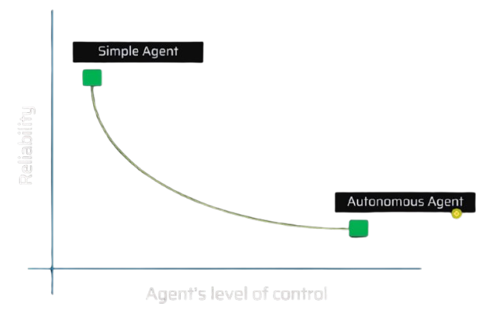
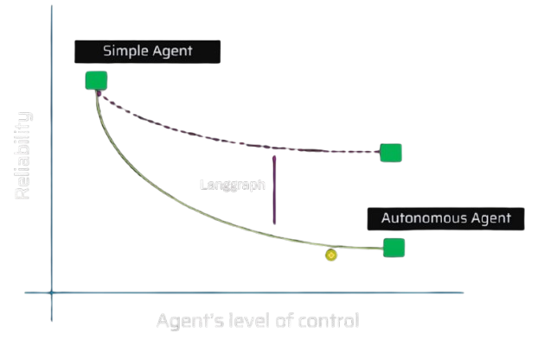
The Agent Reliability Problem
While powerful, autonomous agents can exhibit unpredictable behavior,
often referred to as "crazy things," if not properly constrained.
Managing this unreliability is critical for real-world deployment.
Balancing Autonomy & Reliability
There's an inherent trade-off: as the level of autonomy granted to an agent increases, maintaining its reliability becomes significantly more challenging. Uncontrolled autonomy leads to unpredictable outcomes.
This is where Langgraph steps in. It provides a robust framework designed to enhance the reliability of autonomous agents by offering precise tools and features for stateful management and control.

Slide 5
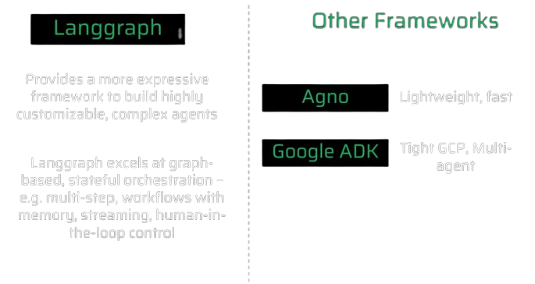
Why Choose LangGraph? A Framework Comparison
LangGraph stands out for its unique approach to orchestrating complex AI workflows, offering deeper control and state management compared to other frameworks.

Slide 6
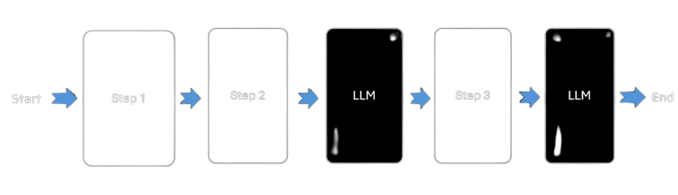
LangChain: Linear Flow
LangChain excels in sequential processing where steps are predefined and follow a clear, one-way path. It's efficient for tasks that don't require complex decision points or returning to previous steps.

Slide 7
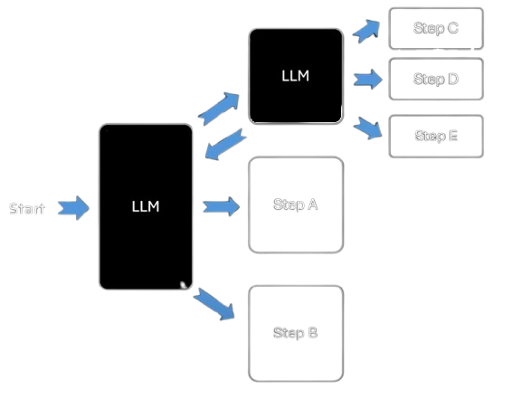
LangGraph: Graph-Based Autonomy
LangGraph empowers LLMs to dynamically decide the next action.
Its graph structure supports loops, conditional branching, and full state persistence, essential for robust, autonomous agents.

Slide 8

LangGraph Core Concepts: Graphs
At its heart, LangGraph utilizes graph theory to
model and manage agentic workflows.
This foundational structure enables flexible and
robust orchestration.
The Graph Data Structure
Composed of nodes (representing specific steps, actions, or decision points).
Connected by edges (representing transitions or relationships between nodes).
This allows for complex, non-linear paths, dynamic decision-making, and looping behavior, unlike simple linear chains.
Think of it like a map where cities are nodes and roads are edges, allowing for diverse travel plans.

Slide 9
Langgraph Core Concepts: Stateful Workflows
A key differentiator for Langgraph is its robust state management, enabling agents to maintain context and adapt their behavior across multiple interactions.
The State Object
A single, mutable object (e.g., a Python dictionary) that encapsulates the entire context and history of the workflow. It's the central source of truth passed between all nodes.
Node Modification
Each node in the graph receives the current state, performs its specific operation or logic, and then updates and returns the modified state. This ensures continuity and data consistency.
Dynamic Progression
The updated state guides the workflow's progression, allowing the agent to make informed decisions about which node to execute next based on the evolving context.

Slide 10




Empowering Enterprise AI with LangGraph
LangGraph's architecture provides the foundation for building resilient and highly capable AI agents that can tackle complex enterprise challenges.
Enhanced Efficiency
Complex Automation
Automate multi-step processes, reducing manual effort and accelerating complex workflows across departments.
Build agents that can perform intricate tasks, from nuanced customer service interactions to advanced data analysis.
Mitigated AI Risks
Intelligent Decisions
Improve control and predictability of autonomous agents, fostering trust and ensuring responsible AI deployment.
Leverage stateful reasoning to enable agents to make context-aware decisions, adapting to real-time information.

Slide 11

The Future is Agentic
"LangGraph isn't just a framework; it's a paradigm shift towards building AI systems that are not only intelligent but also reliable, controllable, and truly autonomous."
Embrace the power of graph-based stateful orchestration to unlock the full potential of agentic AI within your enterprise.
Learn more and start building your reliable agents today.
DEMO

